Slide 1
Application Layer Protocols
Course Code: CSC 3116
Course Title: Computer Networks
Dept. of Computer Science
Faculty of Science and Technology
Lecturer No: | 2 | Week No: | 2 | Semester: | Summer 23-24
Lecturer: | Md. Faruk Abdullah Al Sohan; faruk.sohan@aiub.edu

Slide 2
Lecture Outline
1. Different layers of Protocol
2. Protocol Types
3. HTTP
4. DNS

Slide 3
What is Protocol?
Protocol: In computer networks, communication occurs between entities in different systems. However, two entities can not simply send bit streams to each other and expect to be understood. For communication to occur, the entities must agree on a protocol. A protocol is a set of rules that govern data communications. A protocol defines what is communicated, how it is communicated, and when it is communicated.
Example: HTTP, FTP, TCP, IP etc.

Slide 4
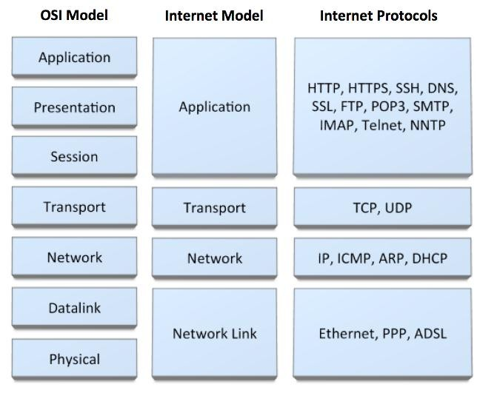
Different Layers Protocol

Slide 5
Protocol Types
PUSH protocol: In push protocols, the client opens a connection to the server and keeps it constantly active. The server will send (push) all new events to the client using that single always-on connection. In other words, the server PUSHes the new events to the client. For example, a server might push notifications to your smartphone, informing you of new messages or updates, without you having to check manually. Example: SMTP
PULL protocol: In pull protocols, the client periodically connects to the server, checks for and gets (pulls) recent events and then closes the connection and disconnects from the server. The client repeats this whole procedure to get updated about new events. In this mode, the clients periodically PULLs the new events from the server. For example, when you type a URL into your browser and hit enter, your browser pulls the web page data from the server, which is then displayed to you. Example: HTTP

Slide 6
Application Layer Protocol: HTTP
HTTP (Hypertext Transfer Protocol) is used across the world wide web (www) for data transfer and is one of the most used application protocols.
HTTP specifies a request/response protocol. When a client, typically a web browser, sends a request message to a server, the HTTP protocol defines the message types the client uses to request the web page and the message types the server uses to respond
The three common message types are:
GET
POST
PUT

Slide 7
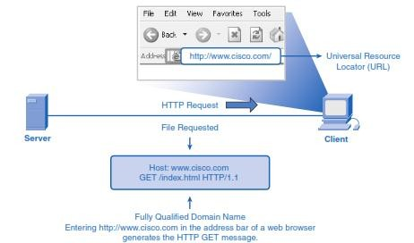
Application Layer Protocol: HTTP (c o n t .)
GET: It is a client request for data. A web browser sends the GET message to request pages from a web server. As shown in Figure, when the server receives the GET request, it responds with a status line, such as HTTP/1.1 200 OK, and a message of its own, the body of which can be the requested file, an error message, or some other information.

Slide 8
Application Layer Protocol: HTTP (c o n t .)
POST and PUT are used to send messages that upload data to the web server. For example, when the user enters data into a form embedded in a web page, POST includes the data in the message sent to the server.
PUT updates resources or content to the web server. For example, if you want to update your profile information on a website, a PUT request is sent to the server with the updated details. The server replaces the old data with the new data at the specified URL, ensuring your profile is updated correctly.

Slide 9
Application Layer Protocol: HTTP runs on T C P
The transfer protocol used throughout the World Wide Web is HTTP (Hyper Text Transfer Protocol).
TCP provides a reliable data transfer service to HTTP, using TCP port 80.
This implies that
Each HTTP request message emitted by a client process eventually arrives in tact at the server; similarly,
Each HTTP response message emitted by the server process eventually arrives in tact at the client.
HTTP need not worry about lost data, or the details of how TCP recovers from loss or reordering of data within the network.
That is the job of TCP and the protocols in the lower layers of the protocol stack

Slide 10
Application Layer Protocol: D N S
Domain Name Service (DNS): DNS provides a core Internet function, translating hostnames to their underlying IP addresses, for user applications and other software in the Internet. The DNS protocol defines an automated service that matches resource names with the required numeric network address. It is essentially the phone book of the internet.
For example, Imagine you want to call a friend, but you only know their name, not their phone number. You look up their name in the phone book, which provides you with their phone number. DNS works similarly: you enter a domain name in your browser, and DNS translates it into the corresponding IP address, allowing your browser to find the right server and display the website.

Slide 11
Application Layer Protocol: D N S
DNS uses a large number of name servers, organized in a hierarchical fashion and distributed around the world. No one name server has all of the mappings for all of the hosts on the internet. Instead, the mappings are distributed across the name servers. There are three types of name servers:
Root name servers
Local name server (Recursive Resolver)
Authoritative name servers

Slide 12
R o o t N a m e S e r v e r
Root name servers: A root server contains information about the root and top-level domains, When a local name server cannot immediately satisfy a query from a host (because it does not have a record for the hostname being requested), the local name server behaves as a DNS client and queries one of the root name servers.
For example, When you type in a domain name, like www.example.com, your query starts at a root name server. The root server does not know the specific IP address of www.example.com, but it knows where to find the .com TLD servers. It directs your query to the .com servers, which then help you find the specific server for example.com.

Slide 13
L o c a l N a m e S e r v e r
Local name server: Each ISP - such as a university, an academic department, an employee's company or a residential ISP - has a local name server (also called a default name server). When a host issues a DNS query message, the message is first sent to the host's local name server. The IP address of the local name server is typically configured by hand in a host.
For example, When you request a website, your computer sends the request to a local name server. If the server has the IP address cached, it returns the address immediately. If not, it queries other DNS servers, including the root and authoritative name servers, to find the IP address and then returns it to your computer.

Slide 14
A u t h o r i t a t i v e N a m e S e r v e r
Authoritative name servers: Every host is registered with an authoritative name server. Typically, the authoritative name server for a host is a name server in the host's local ISP. Many name servers act as both local and authoritative name servers.
It is like the contact information department for a company. If you need to know the direct phone number for someone within the company, you contact this department, which provides accurate and updated contact details.
For example, After a query is directed to the TLD servers (like .com), it is then forwarded to the authoritative name servers for the domain (like example.com). These servers have the final say on what the IP address for www.example.com is and return that information to the recursive resolver, which then sends it back to your browser.

Slide 15
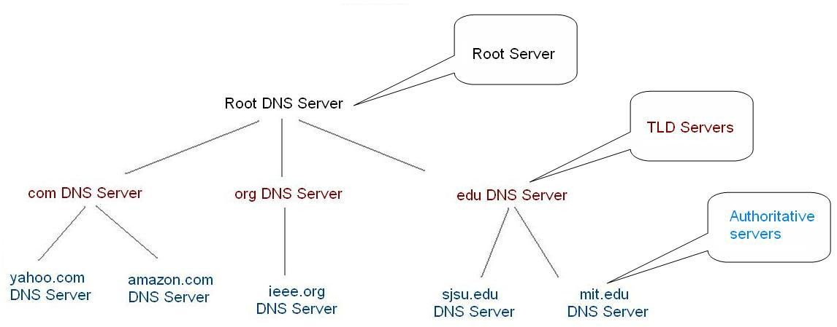
DNS Hierarchy

Slide 16
Internet Domain Names
As an example, consider a namespace with names of the form:
local. site
Where site is the site name authorized by the central authority, local is the part of a name controlled by the site, and (".") is a delimiter used to separate them.
Adding a group subdivision to names already partitioned by site produces the following name syntax:
local. group. site

Slide 17
Internet Domain Names (cont .)
Example: cs.purdue. edu
It contains three labels: cs, purdue, and edu.
Any suffix of a label in a domain name is also called a domain.
In the above example the lowest level domain is cs, (the domain name for the Computer Science Department at Purdue University), the second level domain is purdue (the domain name for Purdue University), and the top-level domain is edu (the domain name for educational institutions).
As the example shows, domain names are written with the local label first and the top domain last.

Slide 18
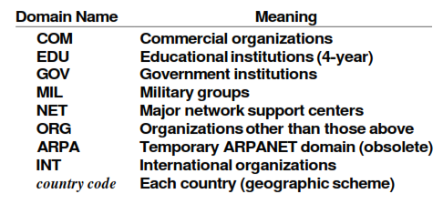
Internet Domain Names (cont .)

Slide 19
DNS: How it works? Example: Hannah want to connect at www.fredsco.com
Hannah opens a browser, types in www.fredsco.com, and sends a DNS resolution request to her DNS (example.com).
example.com's DNS doesn't know the name http://www.fredsco.com. However, the DNS now has some configuration that tells it that if it doesn't know the name, it should ask the DNS server at IP address 1.1.1.1 (Root server).
The DNS server at 1.1.1.1 has a table that lists the IP addresses of a bunch of name servers. DNS server 1.1.1.1 knows that for all names that end in “example.com,“ DNS 150.1.3.4 can resolve the names. It also knows that for all names that end in "fredsco.com," DNS 199.1.1.3 can resolve the names. Finally, DNS server 1.1.1.1 can direct each request to the right name server. This DNS sends a message back to the example.com DNS, referring it to the DNS at 199.1.1.3.

Slide 20
D N S : How it works?
The example.com DNS repeats the name resolution request, now sending the request to the DNS server at Fredsco (199.1.1.3).
The Fredsco DNS gets the request, and it knows the name and IP address.
It sends a reply to the requesting host, namely, example.com's DNS server.
Finally, the example.com DNS server replies to Hannah, telling her that www.fredsco.com resolves to IP address 199.1.1.2.

Slide 21
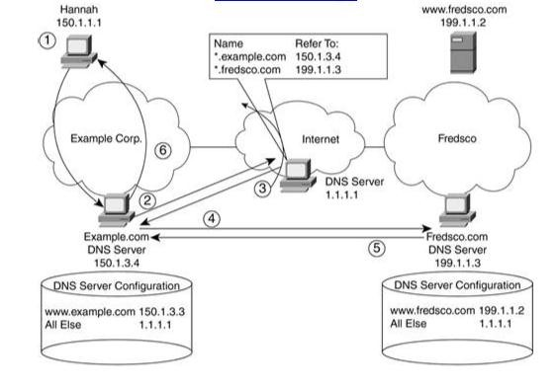
D N S : How it works? (cont.)

Slide 22
Different types of D N S queries
DNS queries can be classified according the manner in which a complete request is processed. Generally, queries can be classified as follows.
Recursive query: A recursive query is a kind of query, in which the DNS server, who received the sender’s query will do all the job of fetching the answer, and giving it back to the sender.
During this process, the DNS server might also query other DNS server's on the internet of the sender’s behalf, for the answer.
Iterative query OR Nonrecursive query: In an iterative query, the name server, will not go and fetch the complete answer for the sender’s query, but will give back a referral to other DNS server's, which might have the answer.

Slide 23
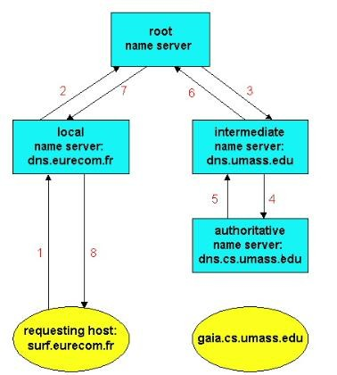
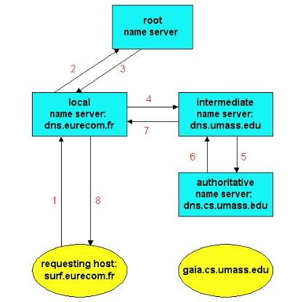
Recursive query/ Iterative query
Fig: A query chain with recursive queries.
Fig: A query chain with iterative queries.

Slide 24
References
Data Communications and Networking, B. A. Forouzan, McGraw-Hill, Inc., Fourth Edition, 2007, USA.
https://www.geeksforgeeks.org/basics-computer-networking/
https://www.tutorialspoint.com/computer_fundamentals/computer_networking.htm

Slide 25
Books
Data Communications and Networking, B. A. Forouzan, McGraw-Hill, Inc., Fourth Edition, 2007, USA.
Computer Networking: A Top-Down Approach, J. F., Kurose, K. W. Ross, Pearson Education, Inc., Sixth Edition, USA.
Official Cert Guide CCNA 200-301 , vol. 1, W. Odom, Cisco Press, First Edition, 2019, USA.
CCNA Routing and Switching, T. Lammle, John Wily & Sons, Second Edition, 2016, USA.
TCP/IP Protocol Suite, B. A. Forouzan, McGraw-Hill, Inc., Fourth Edition, 2009, USA.
Data and Computer Communication, W. Stallings, Pearson Education, Inc., 10th Education, 2013, USA.

